Slide 1
Card Stock Forecast
May 24
Notes:
Order : project plan
Shopee
WMB

Slide 2
AGENDA
Background
Method
Metric
Model Result

Slide 3
Background
On 10 Dec 24 , Jenius plan to launch new design for debit card. As current card stock only sufficient to cover demand until 22 Aug 24 and card production & delivery will take approx. 3 month after request, business urgently need to decide how many card need to be requested to accommodate demand between 22 Aug 24 – 10 Dec 24

Slide 4
Method (Process)
Sample Splitting
Data Preparation & Analysis
Validation sample (20%)
Train Model
Evaluate Model
training sample (80%)

Slide 5
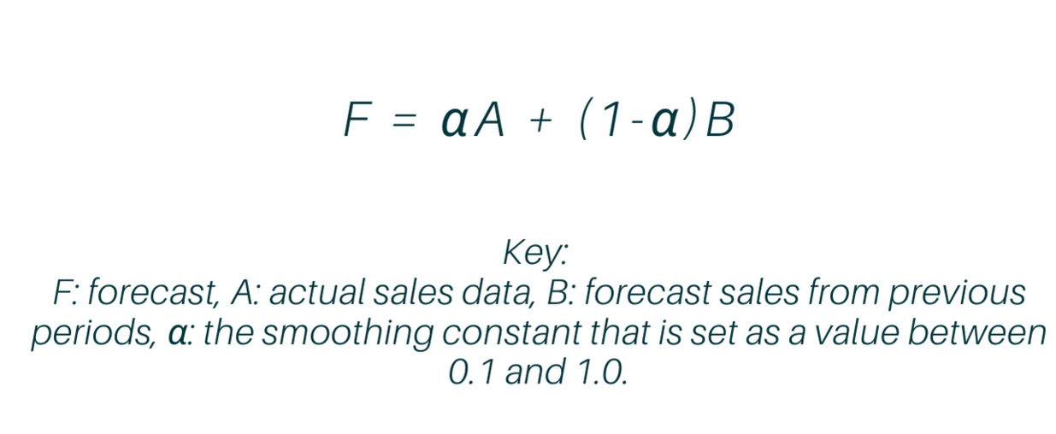
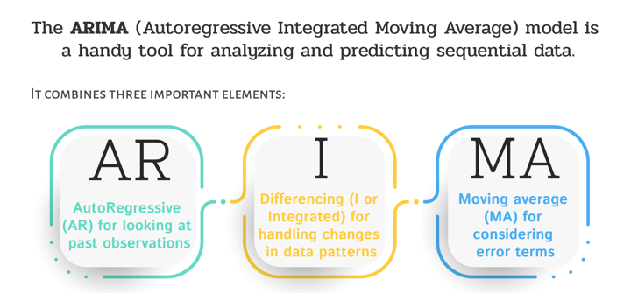
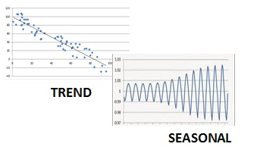
Method
Exponential Smoothing
ARIMA
Exponential Smoothing
Exponential Smoothing with Trend & Seasonal component adjustmentDemographic
Additive &
Multiplicative

Slide 6
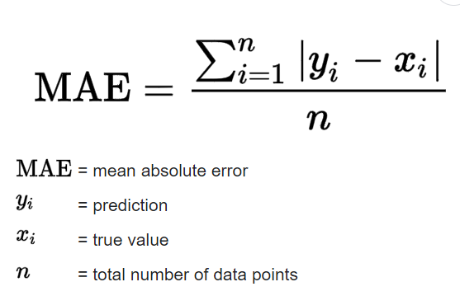
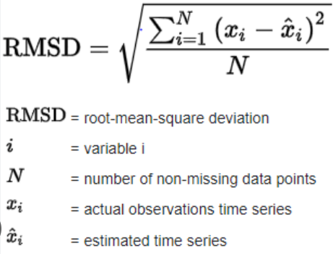
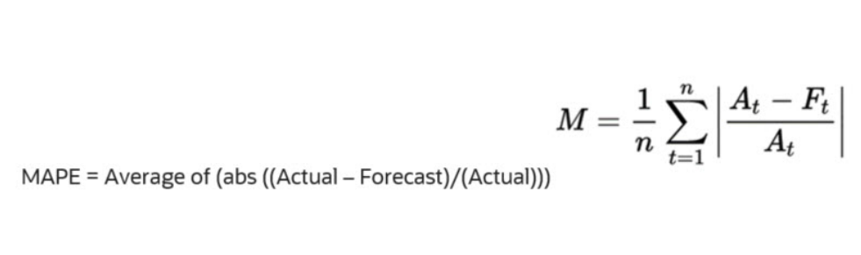
Metrics

Slide 7
Model Result
Error
Error

Slide 8
Model Result
Error
Error

Slide 9
Model Result
Error

Slide 10
Need to Considered
Other Potential Demand :
acquisition from OTO/SOF cross sell
Customer not funded (H+7) will be called by Tele

Slide 11
THANK YOU

